Slide 1
A Novel Framework for Understanding Abnormality in Images
Ph.D. thesis defense
Babak Saleh
Department of Computer Science, Rutgers University
October 28, 2016
Thesis committee:
Prof. Ahmed Elgammal (Chair)
Prof. Jacob Feldman
Prof. Kostas Bekris
Prof. Devi Parikh (Georgia Tech, Facebook AI Research)
Notes:
Good afternoon, thank you for attending my defense talk, which I will be talking about my research on detecting abnormalities in images.
This research would not be possible without the full support and supervision of professor elgammal. Also I am thankful to my committee, Prof. Feldman, Prof. Bekris and Prof. Parikh.

Slide 2
Outline
Motivation
Related Work
Problem Definition
Data Collection
Computational Models
Abnormal Object Detection
Taxonomy of Abnormalities in Images
Role of Typicality in Object Classification
Future Work
Notes:
I start my talk by a brief discussion about why we need to study abnormality in images and what has been studied in prior arts.
Next, we will define the problem more rigorously, collect data and build computational models to approach this problem. I will wrap up with some discussion about future work

Slide 3
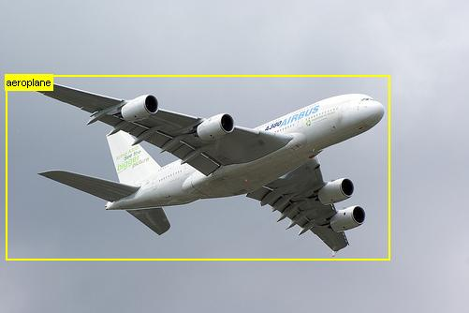
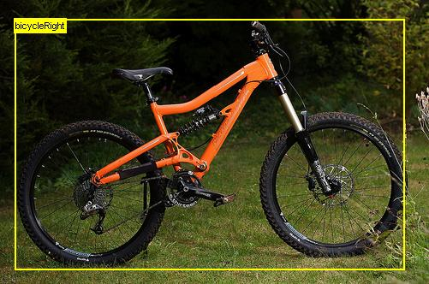
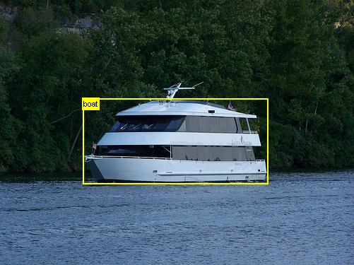
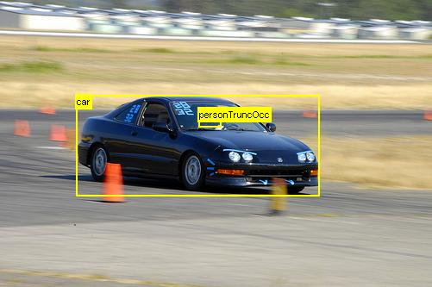
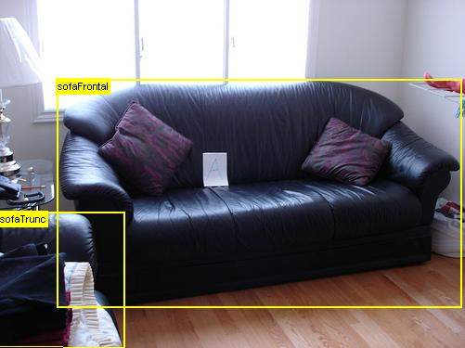
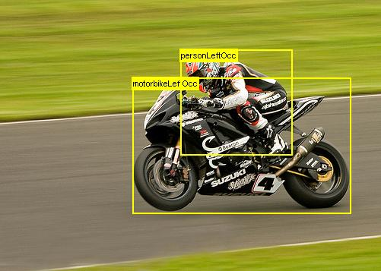
Motivation
Notes:
There has been a great progress in the field of computer vision for object recognition tasks.
Now, we have reliable object detectors that can spot hundreds of object categories in a fraction of a second

Slide 4
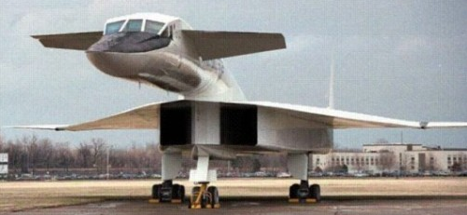
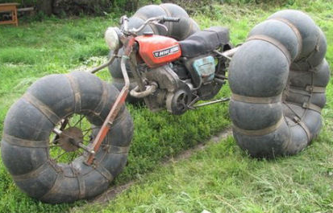

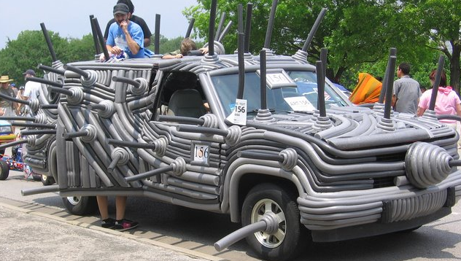
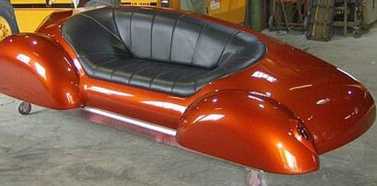
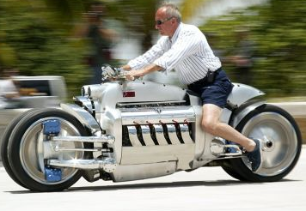
Motivation
Notes:
However, when we apply them on abnormal/atypical images ... they fail drastically

Slide 5
Motivation
Prior arts in object detection (Non-CNN based) failed to detect and classify abnormal objects.
Part-based models (Felzenswalb et al, PAMI’10) in average achieves 8% recognition accuracy on abnormal images.
State-of-the-art (CNN based models) fail drastically to recognize abnormal objects.
Normal
Normal
Abnormal
Abnormal
Notes:
For further analysis of these failure cases, I used two major categories of object classifiers on abnormal images.
First, I adopted a Deformable Part Based model, which was the state of the art till 2012. However, it did not perform better than 8% when tested on abnormal objects
Second, I tested glorious deep learning models on both normal and abnormal images. Both top-5 and top-1 error rates indicate the low-performance of these object classifiers on atypical images.
These images look very different from previous slide, but still easy to understand and recognized for humans
This shows fascinating capability of human vision, which is missing in state-of-the-art approaches in computer vision.
Interestingly, superior performance of human vision goes beyond just naming the categories of these images. For example, when you look at …

Slide 6
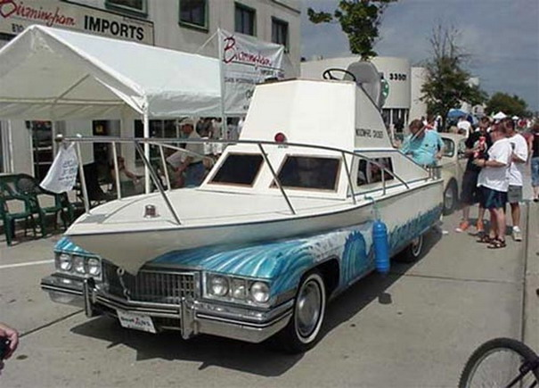
It looks weird!!
Notes:
This picture, without seeing this kind of abnormality before you can easily understand that there is something wrong with this object, you can infer the relevant categories and reason about what makes this instance atypical.

Slide 7
It looks weird!!
However it looks like a Car and a Boat
Notes:
For example, one might say It looks like a car and a boat.

Slide 8
It looks weird!!
However it looks like a Car and a Boat
Boat with a wheel??
Car with a bow?
Notes:
If this is car, then why it has a bow
it is strange to see a boat in the middle of a street,
But If this is a boat then why it has wheels on it
In this thesis we argue that abnormality should be modeled from normality. We consider abnormality as meaningful deviations from normality. In our formulation we need to understand typicality and introduce ways to discover meaningful deviations from it.

Slide 9
Motivation
A better understanding of abnormality in images. Why humans are much better than computers at recognizing these images?
Computational models to detect and reason about abnormality in images.
Closing the gap between humans and computer algorithms on generalizing visual concepts to abnormal cases.
Notes:
These observations motivated me to look for a better understanding of …

Slide 10
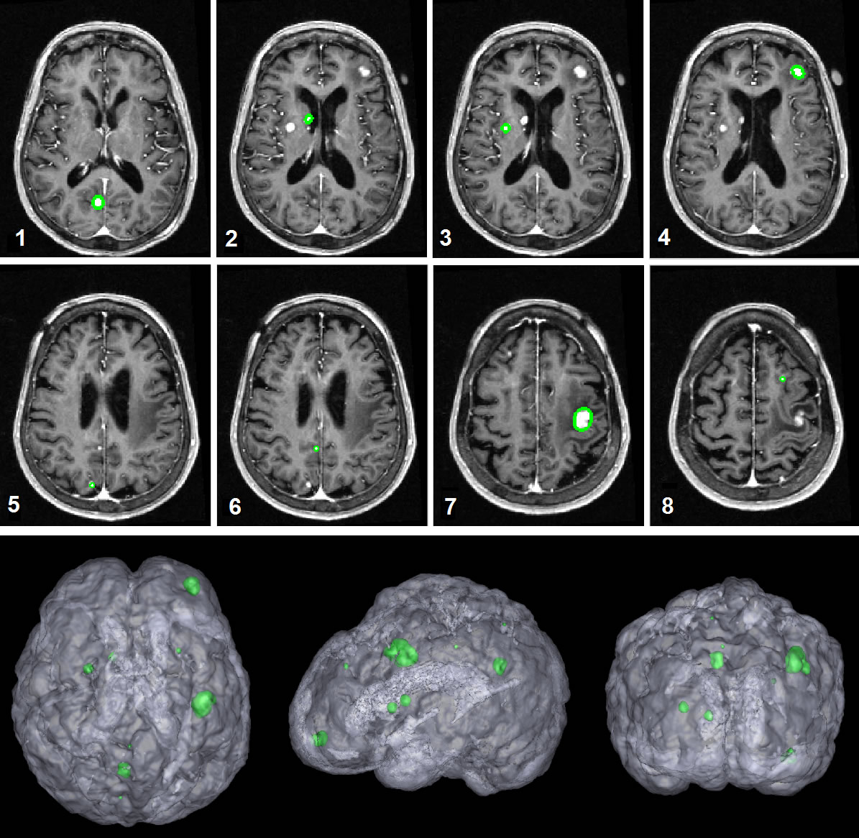
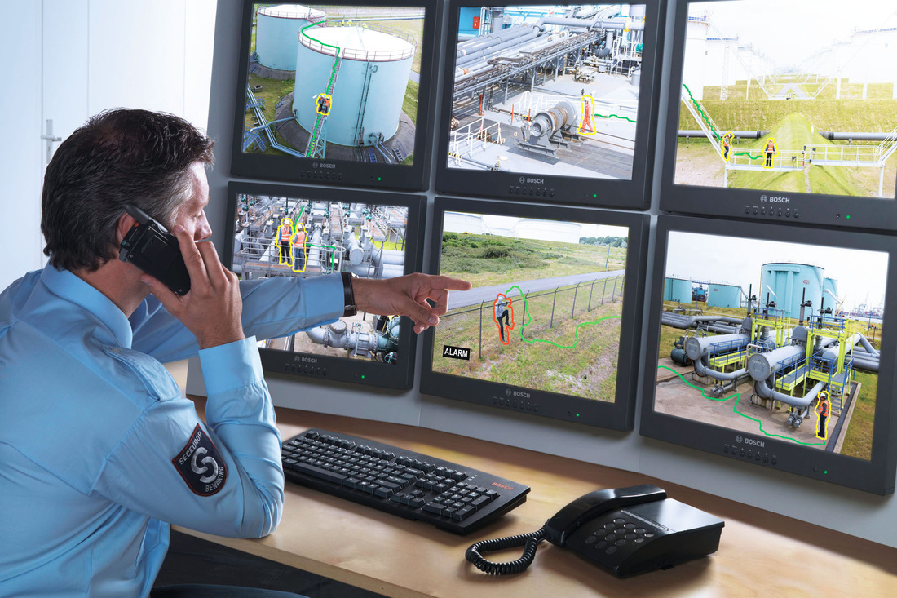
Related Work
Anomaly detection in machine learning
Fraud detection[Tandon’07, Sebyala’04]
Text analysis [Chandola’09]
Abnormality detection in computer vision
Medical imaging
[Wong’03, Agarwal’05]
Video surveillances
[Ivanov’99, Pokrajac’07]
Notes:
Abnormality detection has been studied extensively in the field of machine leaning for a variety of applications such as credit card fraud detection, or detecting irregular exchanged emails.
However, within the computer vision community, abnormality detection has been limited to spotting irregular activities for surveillance applications or recognizing abnormal patterns in medical imaging.
Outside computer vision literature, anomaly detection
has been studied in a wide variety of applications ranging
from credit card fraud to health care systems. Space does
not allow a comprehensive review of this literature. We refer
interested readers to [3 ]. In terms of using abnormal
instance, several methods need to observe abnormal examples
to model abnormality. This is not feasible in images as degrees of variations among atypical instances are unmanageably
large. Our model appears in the group of methods
that only require observation of the normal instance. Our
model predicts abnormality by reasoning about normality
in terms of attributes.
FROM PROPOSAL
The problem of abnormality detection for single images is not really well ex-
plored. Boiman and Irani [5] studied the problem of irregularities in images and videos. In their denition,
irregularities happen when a visual data cannot be composed by a large number of previously known data.
They have shown interesting examples and applications in human activity recognition and detecting salient
parts of images. This approach does not address our concern as the intraclass variations are much higher than
their cases. Detecting salient regions in images has attracted many researchers [33, 35]. Our goal is dierent
from saliency detection abnormalities in object are not necessarily aligned with denitions of saliency in the
literature. Abnormalities and unusual behaviors have been studied in the context of human activity and
event recognition. Zhong et. al.[72] consider an event to be unusual if there are not enough similar events in
the dataset. Stauer and Grimson [62] nd unusual events using the same core idea that unusual events and
activities are those that appear very rarely. Y. A. Ivanov and Bobick [34] use a rule-based models detect
suspicious activities.
----- Meeting Notes (4/16/14 19:12) -----
Chandola

Slide 11
Related Work
Prototype theory in psychology [Feldman’00; Feldman’03; Kamp& Partee’95; Osherson& Smith’81; Rosch and Mervis‘75; Keselman and Dickinson’05]
Memorability [Isoal’13] , Saliency Detection [Judd’09], Human Attention [Murphy’02]
Focus of this thesis is on finding abnormalities in generic images that can be found everywhere.
Notes:
Outside computer vision literature, anomaly detection
has been studied in a wide variety of applications ranging
from credit card fraud to health care systems. Space does
not allow a comprehensive review of this literature. We refer
interested readers to [3 ]. In terms of using abnormal
instance, several methods need to observe abnormal examples
to model abnormality. This is not feasible in images as degrees of variations among atypical instances are unmanageably
large. Our model appears in the group of methods
that only require observation of the normal instance. Our
model predicts abnormality by reasoning about normality
in terms of attributes.
FROM PROPOSAL
The problem of abnormality detection for single images is not really well ex-
plored. Boiman and Irani [5] studied the problem of irregularities in images and videos. In their denition,
irregularities happen when a visual data cannot be composed by a large number of previously known data.
They have shown interesting examples and applications in human activity recognition and detecting salient
parts of images. This approach does not address our concern as the intraclass variations are much higher than
their cases. Detecting salient regions in images has attracted many researchers [33, 35]. Our goal is dierent
from saliency detection abnormalities in object are not necessarily aligned with denitions of saliency in the
literature. Abnormalities and unusual behaviors have been studied in the context of human activity and
event recognition. Zhong et. al.[72] consider an event to be unusual if there are not enough similar events in
the dataset. Stauer and Grimson [62] nd unusual events using the same core idea that unusual events and
activities are those that appear very rarely. Y. A. Ivanov and Bobick [34] use a rule-based models detect
suspicious activities.
----- Meeting Notes (4/16/14 19:12) -----
Chandola

Slide 12
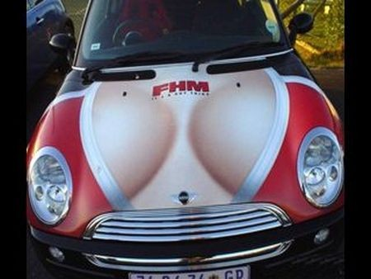
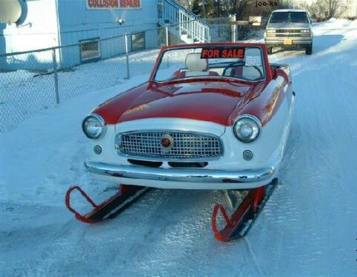
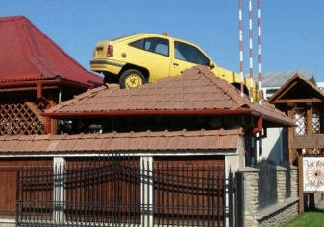
Problem Definition
What is abnormal object/image?
Not a well-agreed answer.
What makes an object/image look strange?
Shape, parts, texture.
Why abnormality happens?
Unexpected context, relative size, strange location.
Notes:
Even a child can figure out something looks strange, but still there is no clear definition for being normal.
What take you to decide an object is abnormal? Some missing parts?(like a car without wheels) Unexpected features(a pink elephant)? Or even whole object structure?(a hamburger shaped sofa)
Is it always because of the object? NO! an elephant in a living room is abnormal. a car on top of the roof is abnormal
Rick point ++ functionality
Cup + star shape
Careful about being like human

Slide 13
Data Collection

Slide 14


Object class +names
from
Pascal
Abnormal
Weird
Strange
Atypical
Weird Car, Strange Sofa, etc.
Human Subject Experiment
Pruning:
Low Quality
Duplicity
Irrelevant
Notes:
To make this dataset, We put strange keywords in image search engines and collected an initial set of images.
later we remove duplicates, low quality and totally irrelevant ones,
next we conduct human subject experiments on Amazon mechnical turk to:

Slide 15
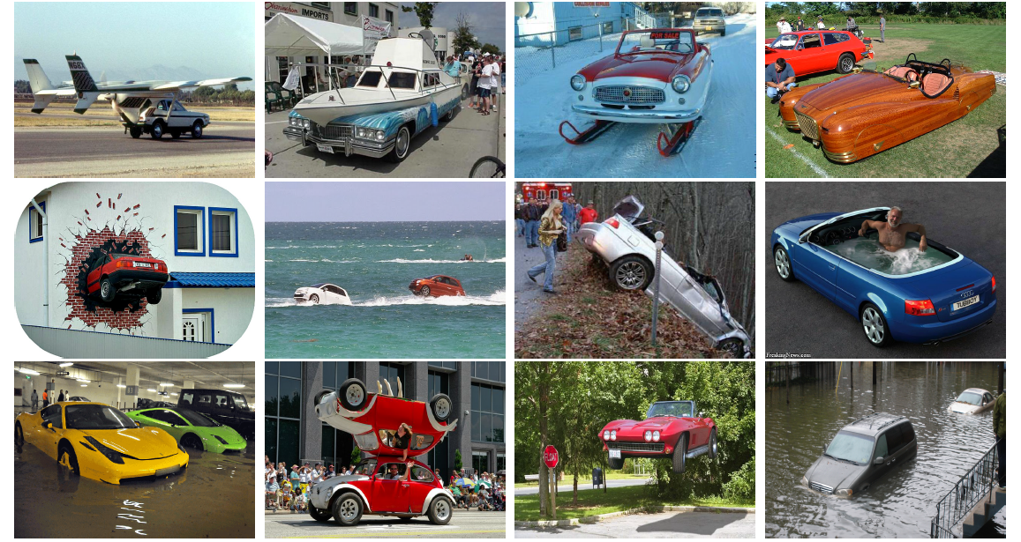
1001 Abnormal Image Dataset
Notes:
To answer these questions, we built the first public dataset of abnormal images. As you can see there are a wide range of abnormalities In the images of our collection.

Slide 16
Human Subject Exp. I
The goal of the first round of our human subject experiment is manifold:
Verifying that our image collection is abnormal.
Abnormality rating for objects as a graded concept.
Delving into reasons that cause abnormality in objects.
Rich set of annotation in terms of object categories and abnormality reasons.

Slide 17
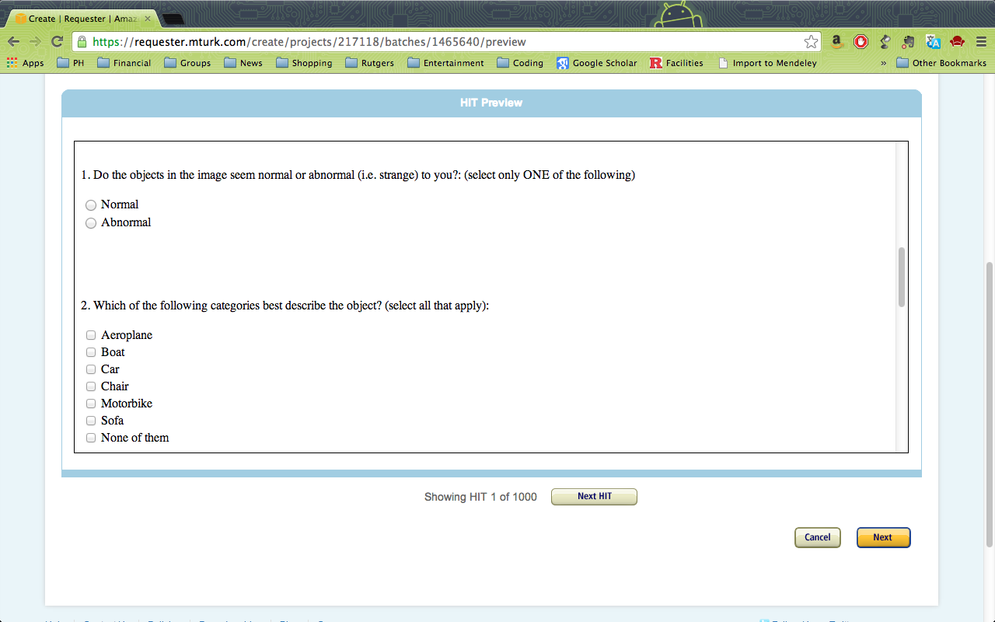

Slide 18
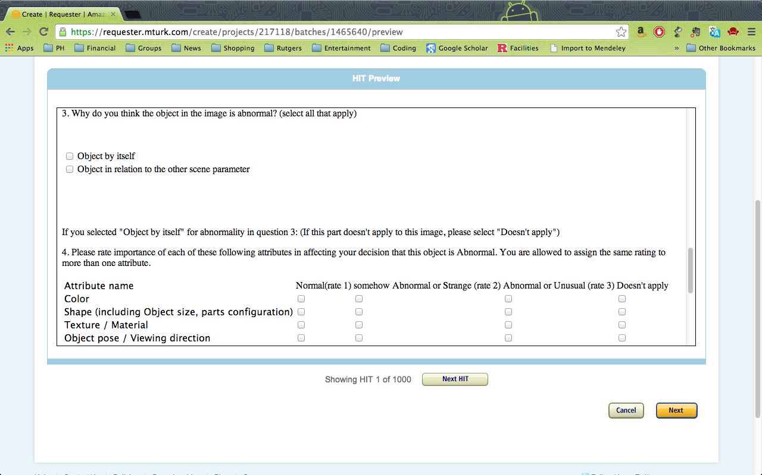

Slide 19
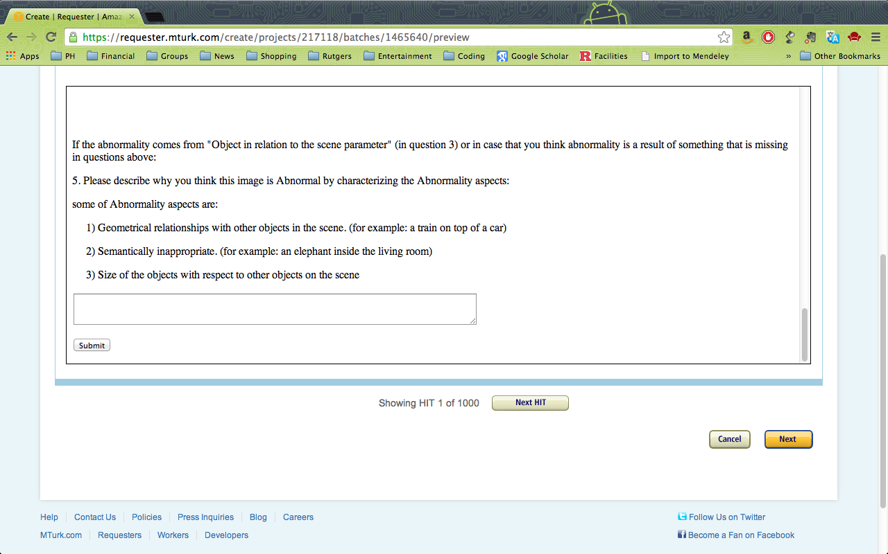

Slide 20
Dataset Statistics:
Category Membership
Categorization of abnormal objects are harder than regular objects.
Even humans are not in a total agreement about the category membership of abnormal objects.
Confusion Matrix - Object Categorization – Abnormal Objects
Notes:
As you can see people are not sure object class of abnormal images. Especially for the case of sofa and chair
airplane +boat, car+ boat
For the reason of being abnormal: shape usually wins the scores
Variance of rating for class of airplane is bigger than others due to different airplane that you would expect

Slide 21
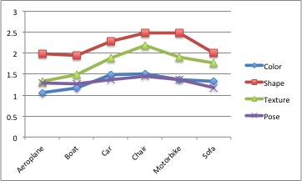
Dataset Statistics: Abnormality Reasons
Human subject scores averaged for each one of four reasons.
Independent of the object category, Shape is the 1st reason for making an object abnormal. Followed by Texture, Color and Pose.

Slide 22
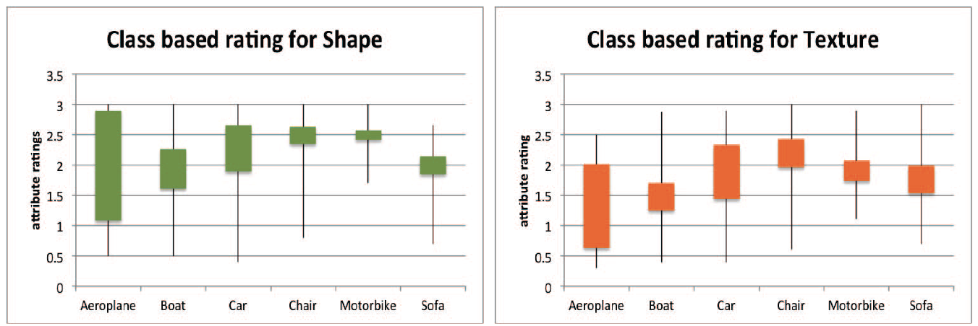
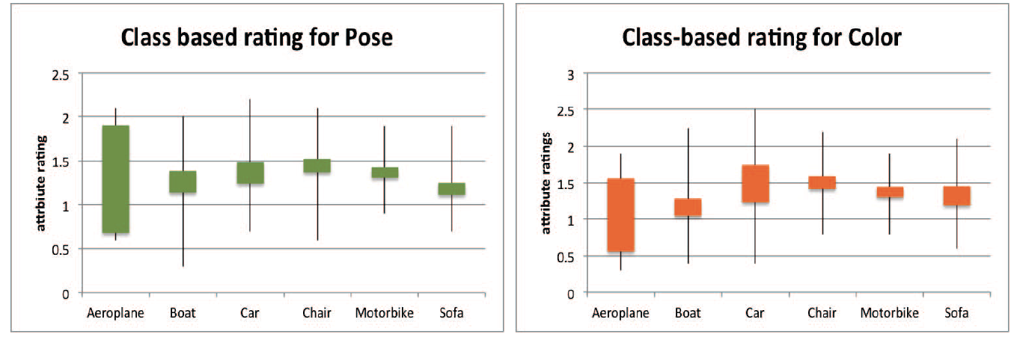
Dataset Statistics: Abnormality Reasons
Confidence of reasoning about abnormality varies from one category to another.

Slide 23
Computational Models:
I. Abnormal Object Detection
“Object-Centric Anomaly Detection by Attribute-Based Reasoning”; B. Saleh, A. Farhadi, A. Elgammal. CVPR 2013
“Detecting Strange Object via Visual Attributes”; B. Saleh, A. Elgammal, A. Farhadi. ECCVW 2014
“Recognition of Abnormal Images and Reasoning about Strange Objects via Visual Attributes”; B. Saleh, A. Farhadi, A. Elgammal. Under Submission. In preparation TPAMI 2016
Notes:
Next, I will talk about computational models that we built for detecting abnormal objects.
Where …

Slide 24
Abnormal Object Detection
We focus on abnormality stemming from object by itself, NOT coming from the context.
We should NOT learn on top of abnormal samples
It is not a two way classification problem.
Imbalanced data
Uncontrolled variations in the visual space
Human-like vision
We just learn the model based on normal samples and define:
“Abnormality is Meaningful Deviation from Normality”
Notes:
... Not two way classification problem, because : 1) there is an unmanageable imbalanced data situation
2) Against human learning of a visual concept. Recognizing abnormalities, even without seeing it before.
*********************************************************
1) Although there are different reason for being abnormal, we are considering ones that are related to the object
2) How many images from normal cars we can gather? What about abnormal ones? It is not a fair learning situation
3) We can not say we know all the reason for being abnormal! So we can not conclude all of our abnormal images cover all the reason of being abnormal

Slide 25
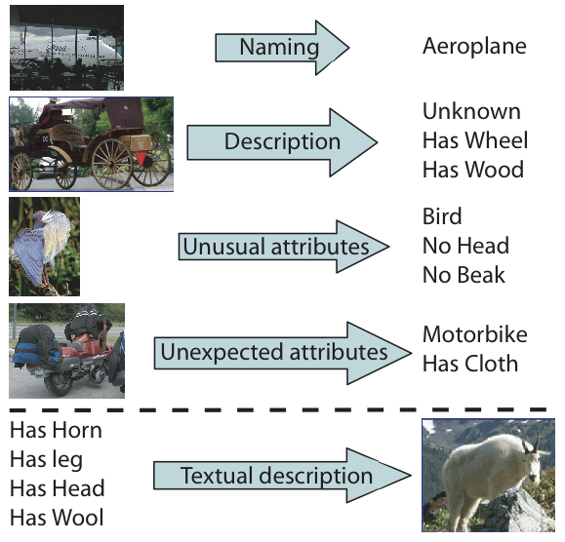
Visual Attribute
Semantically meaningful visual characteristics. [Farhadi et al.’09]
Pre-defined list of attributes, usually require expert knowledge.
Visual classifiers for each attribute, trained on low-level visual features (HoG, SIFT, etc.)
Shareable between object categories. Normal and Abnormal objects.
Notes:
Before moving forward developing the model, I should talk about the concept of visual attributes that plays an important role in our computational models.

Slide 26
Abnormal Object Detection
Graphical Model for Normality (N)
C: object Category, A: visual Attributes
Notes:
An object can a get score probability for being Normal which its complement will be its abnormality score, and have a distribution over object classes. Normal objects belong to one class.
Then object class distribution for normal images should be uni-modal and peaky around one node.
Probability of object classes impose a distribution over visual attributes.
And these attributes can be observed using running attribute classifier over low-level visual features.
Since attributes are shared across categories, we can connect each attributes to all the classes and vice versa

Slide 27
Surprise Score for Abnormality
Abnormal Object Detection
The amount of information produced by an attribute is different from one category to another.
We measure it via information theory
Attribute classifiers are noisy!
Measure reliability of attributes as its accuracy over validation set.
Notes:
Relevance is learned on top of normal
If distribution P(A|C,N) is peaky it should be relevant and discriminative for purpose of abnormality detection

Slide 28
Surprise Score for Abnormality
Abnormal Object Detection
Importance of visual attributes is dependent on the object category.
Compute relevance of an attribute over training set once.
Surprise score is aggregation over all attributes and object categories.
Notes:
Relevance is learned on top of normal
If distribution P(A|C,N) is peaky it should be relevant and discriminative for purpose of abnormality detection

Slide 29
Abnormal Object Detection
Based on Abnormality Score from the Normality model, we can classify an object as Normal vs. Abnormal.
Method | AUC
One class SVM | 0.5980
Two class SVM | 0.8657
Graphical Model | 0.8703
Our Model with surprise score | 0.9105
Notes:
Although We are learning on top of Abnormal, still beat the result of a two
way classifier learned on top of Abnormal objects along with Normal objects
Not all of the attributes are important for one class of objects
Some are more important.
Entropy of an attribute given its object class.

Slide 30
Abnormal Object Ranking
Based on surprise scores we are able to rank images, showing how strange they look like.
Less Abnormal
Highly Abnormal

Slide 31
Abnormality Reasoning
Given the object category, one can measure the surprise score of the observed value of an attribute.
Grouping attributes into Shape, Color, Texture and Pose. Consequently average corresponding surprise scores to compare them with human response.

Slide 32
Abnormal Object Reasoning Via Visual Attributes
KL Divergence between two distribution [1) Model 2) Human Sub. Exp.]
Method | Airplane | Boat | Car | Chair | Motorbike | Sofa | Average
Baseline I* | .0796 | .0801 | .0775 | .1035 | .0944 | .064 | .0832
Baseline II* | .0826 | .0768 | .0809 | .0956 | .0892 | .0565 | .0803
Our Model | .0567 | .0369 | .0758 | .0631 | .0635 | .0695 | .0609
*“Describing objects by their attributes”, Farhadi et al. CVPR’09
Notes:
For the task of abnormality reason based on four categories of reasons: shape, texture, color, pose
For each reason one score coming from human subject experiment
Our model produce a score as well.
Just measure how similar is our distribution compare to humans? Using KL divergence , lower number is better

Slide 33
Abnormality Reasoning
Compute signed surprise score in order to report missing (negative surprise), or unexpected (positive surprise) attributes.

Slide 34
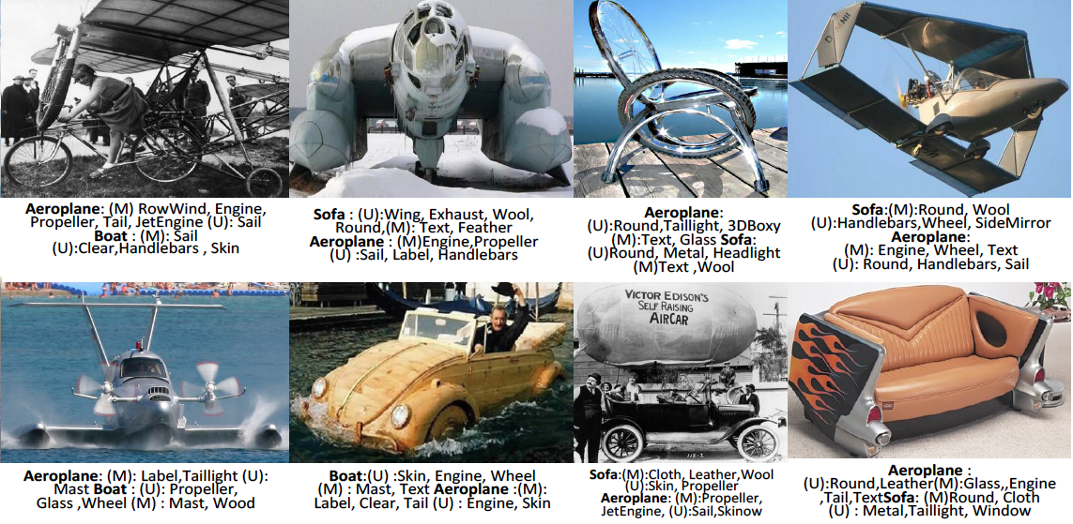
Abnormal Object Reasoning Via Visual Attributes

Slide 35
Computational Models:
II. Taxonomy of Abnormalities in Images
“Toward a Taxonomy and Computational Models of Abnormalities in Images”; B. Saleh, A. Elgammal, J. Feldman, A. Farhadi. Best Paper Award AAAI 2016
“A Comprehensive Study of Abnormality Reasons in Images”; B. Saleh, A. Elgammal, J. Feldman, A. Farhadi. In preparation JAIR 2016.
“Wow! That looks strange: computational models for detection and reasoning about abnormality in images” ACM AI Matters 2016.
Notes:
Next, we moved to a bigger picture, looking forward to build a taxonomy of reasons for abnormality in images.

Slide 36
Problem Definition
Comprehensive understanding of what can cause abnormality? Going beyond abnormal objects
However, the taxonomy of possible reasons for abnormality in images is not defined
Still, this is Not a two-way classification
We use Information theoretic approaches, because it mimics human reasoning about these images
Notes:
Our goal was to come up with a comprehensive understanding ….
... As a result, for the firs step we should propose such a taxonomy
… Following up with this taxonomy, we want to build computational models of abnormlaity recognition. But still ....
We used information theory to infer surprise scores for images.

Slide 37
Human Subject Exp. II
Investigating human thinking about abnormality
Proposing a taxonomy of reasons that can make an image look abnormal.
Two-fold human subject experiment:
On-site: making an initial list of reasons (4 subjects)
Outcome: List of 21 reasons of abnormality in images
Online: extending the taxonomy, image annotation (60 unique subjects, 10 round for each image)

Slide 38
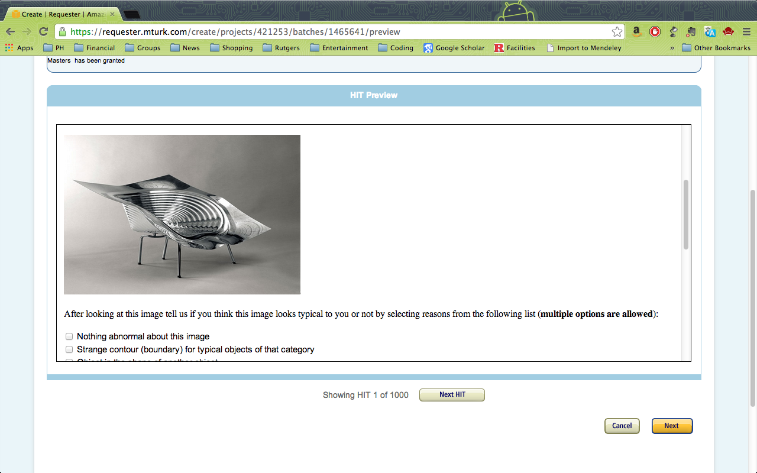
*Nothing abnormal about this image
*Strange contour (boundary) for typical objects of that category
*Object in the shape of another object
*Object is not complete
*object is not complete
*missing specific part(s)
*misplaced part(s)
*weird-shaped part(s)
*unexpected parts, extra parts
*strange texture
*strange color
*strange pattern
*atypical material
*something wrong with the shape of the
object, but I cannot easily name it
*atypical combination of categories
*strange body posture

Slide 39
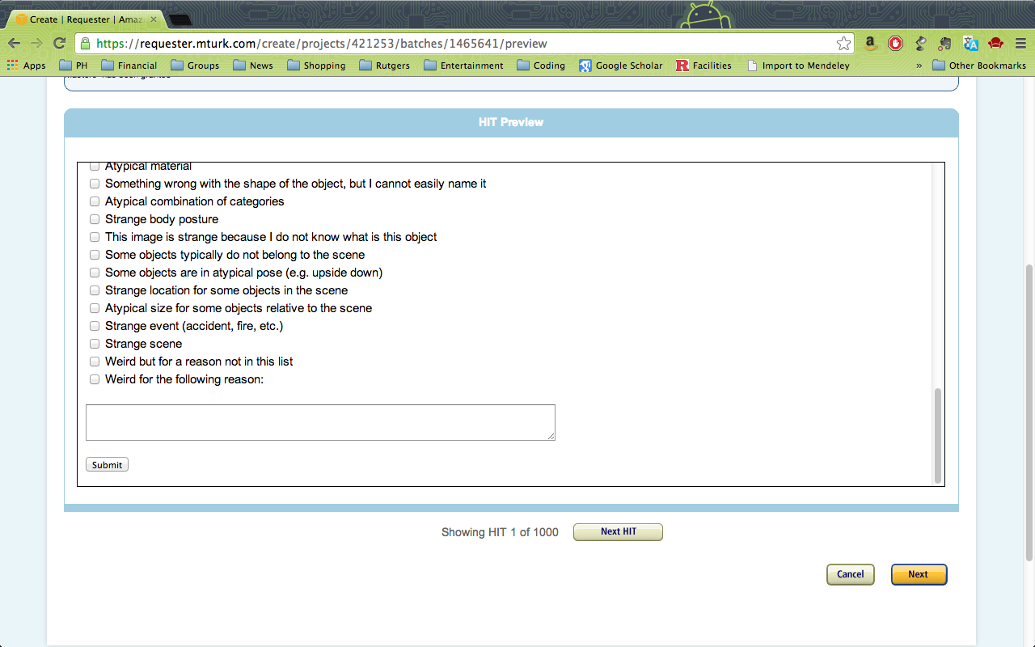
*image is strange because I do not know
what is this object
*some objects typically do not belong to the scene
*some objects are in atypical pose (e.g upside down)
*strange location for some objects
*atypical size for some objects relative to the scene
*strange event (accident, fire, etc.)
*strange scene
*weird but for a reason not in this list
Notes:
AT THE END WE CAME UP WITH 21 UNIQUE REASONS OF ABNORMALITY AND FOR A GIVEN IMAGE WE HAVE SCORES FOR EACH OF THESE REASONS.

Slide 40
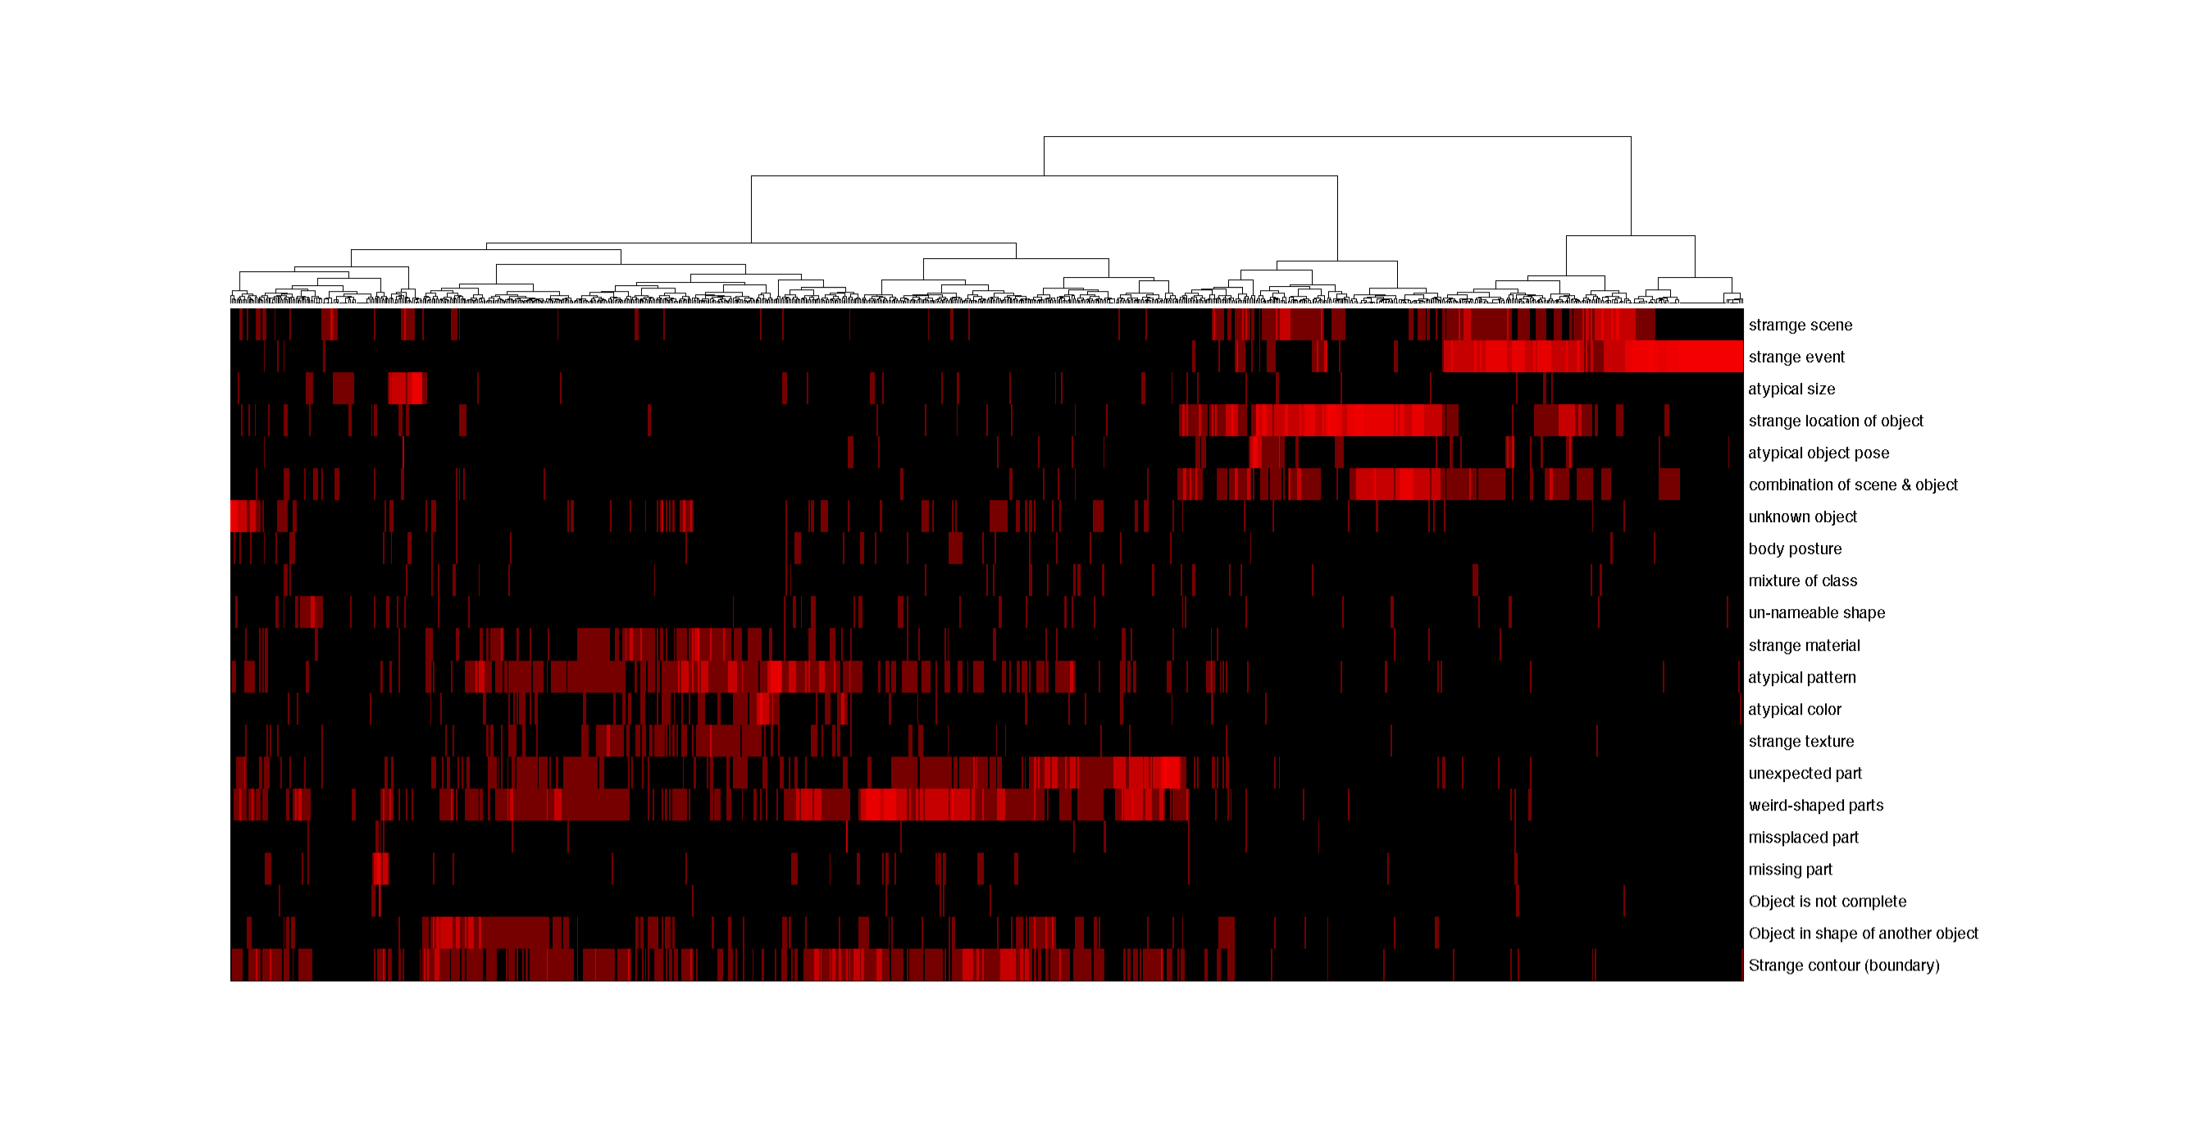
For all images, average responses of 10 users
bottom-up agglomerative clustering
Ward’s minimum variance criteria as the Linkage function
Three main branches on top
Reasons
Average response
Images
Notes:
We average responses for 21 reasons of abnormality over all human subjects, resulting in 21-dim vector for each image.
Hierarchical clustering of images based on these responses results in this dendrogram.
Cutting it on very top, would result in three clusters.

Slide 41
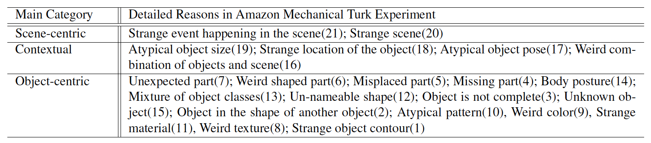
Notes:
When we browse reasons of abnormality corresponding to each cluster, we can name the cluster based on the common theme of the reasons.

Slide 42
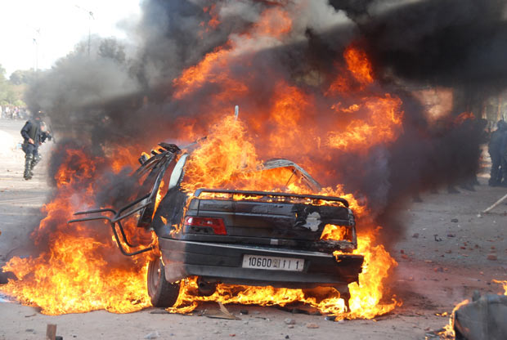
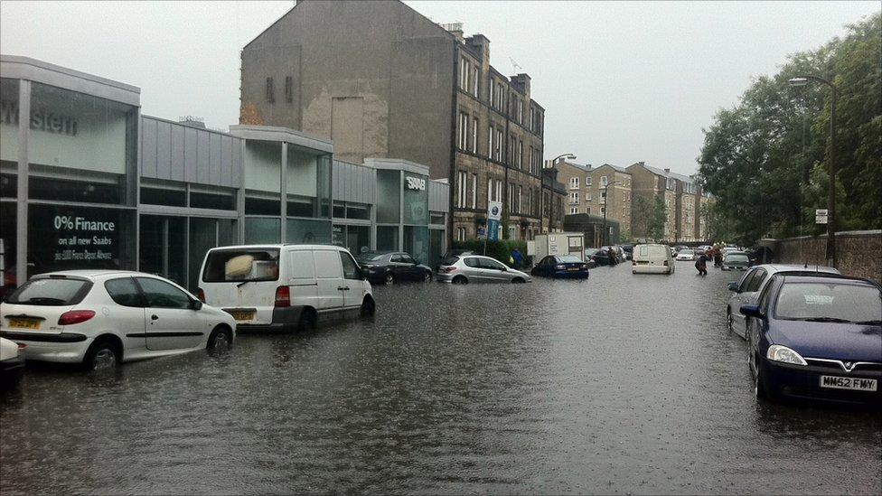
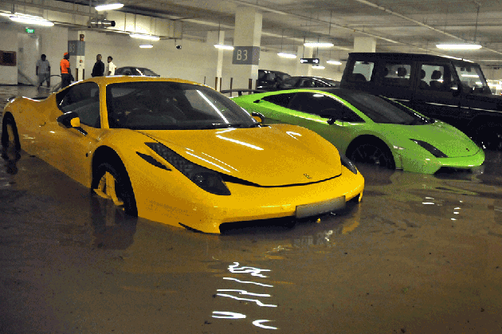
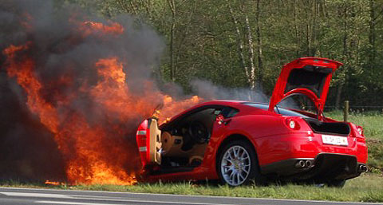
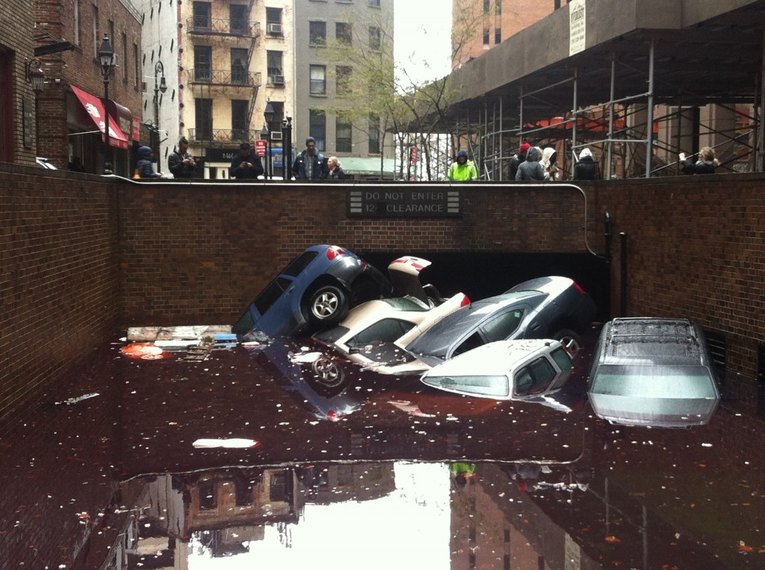
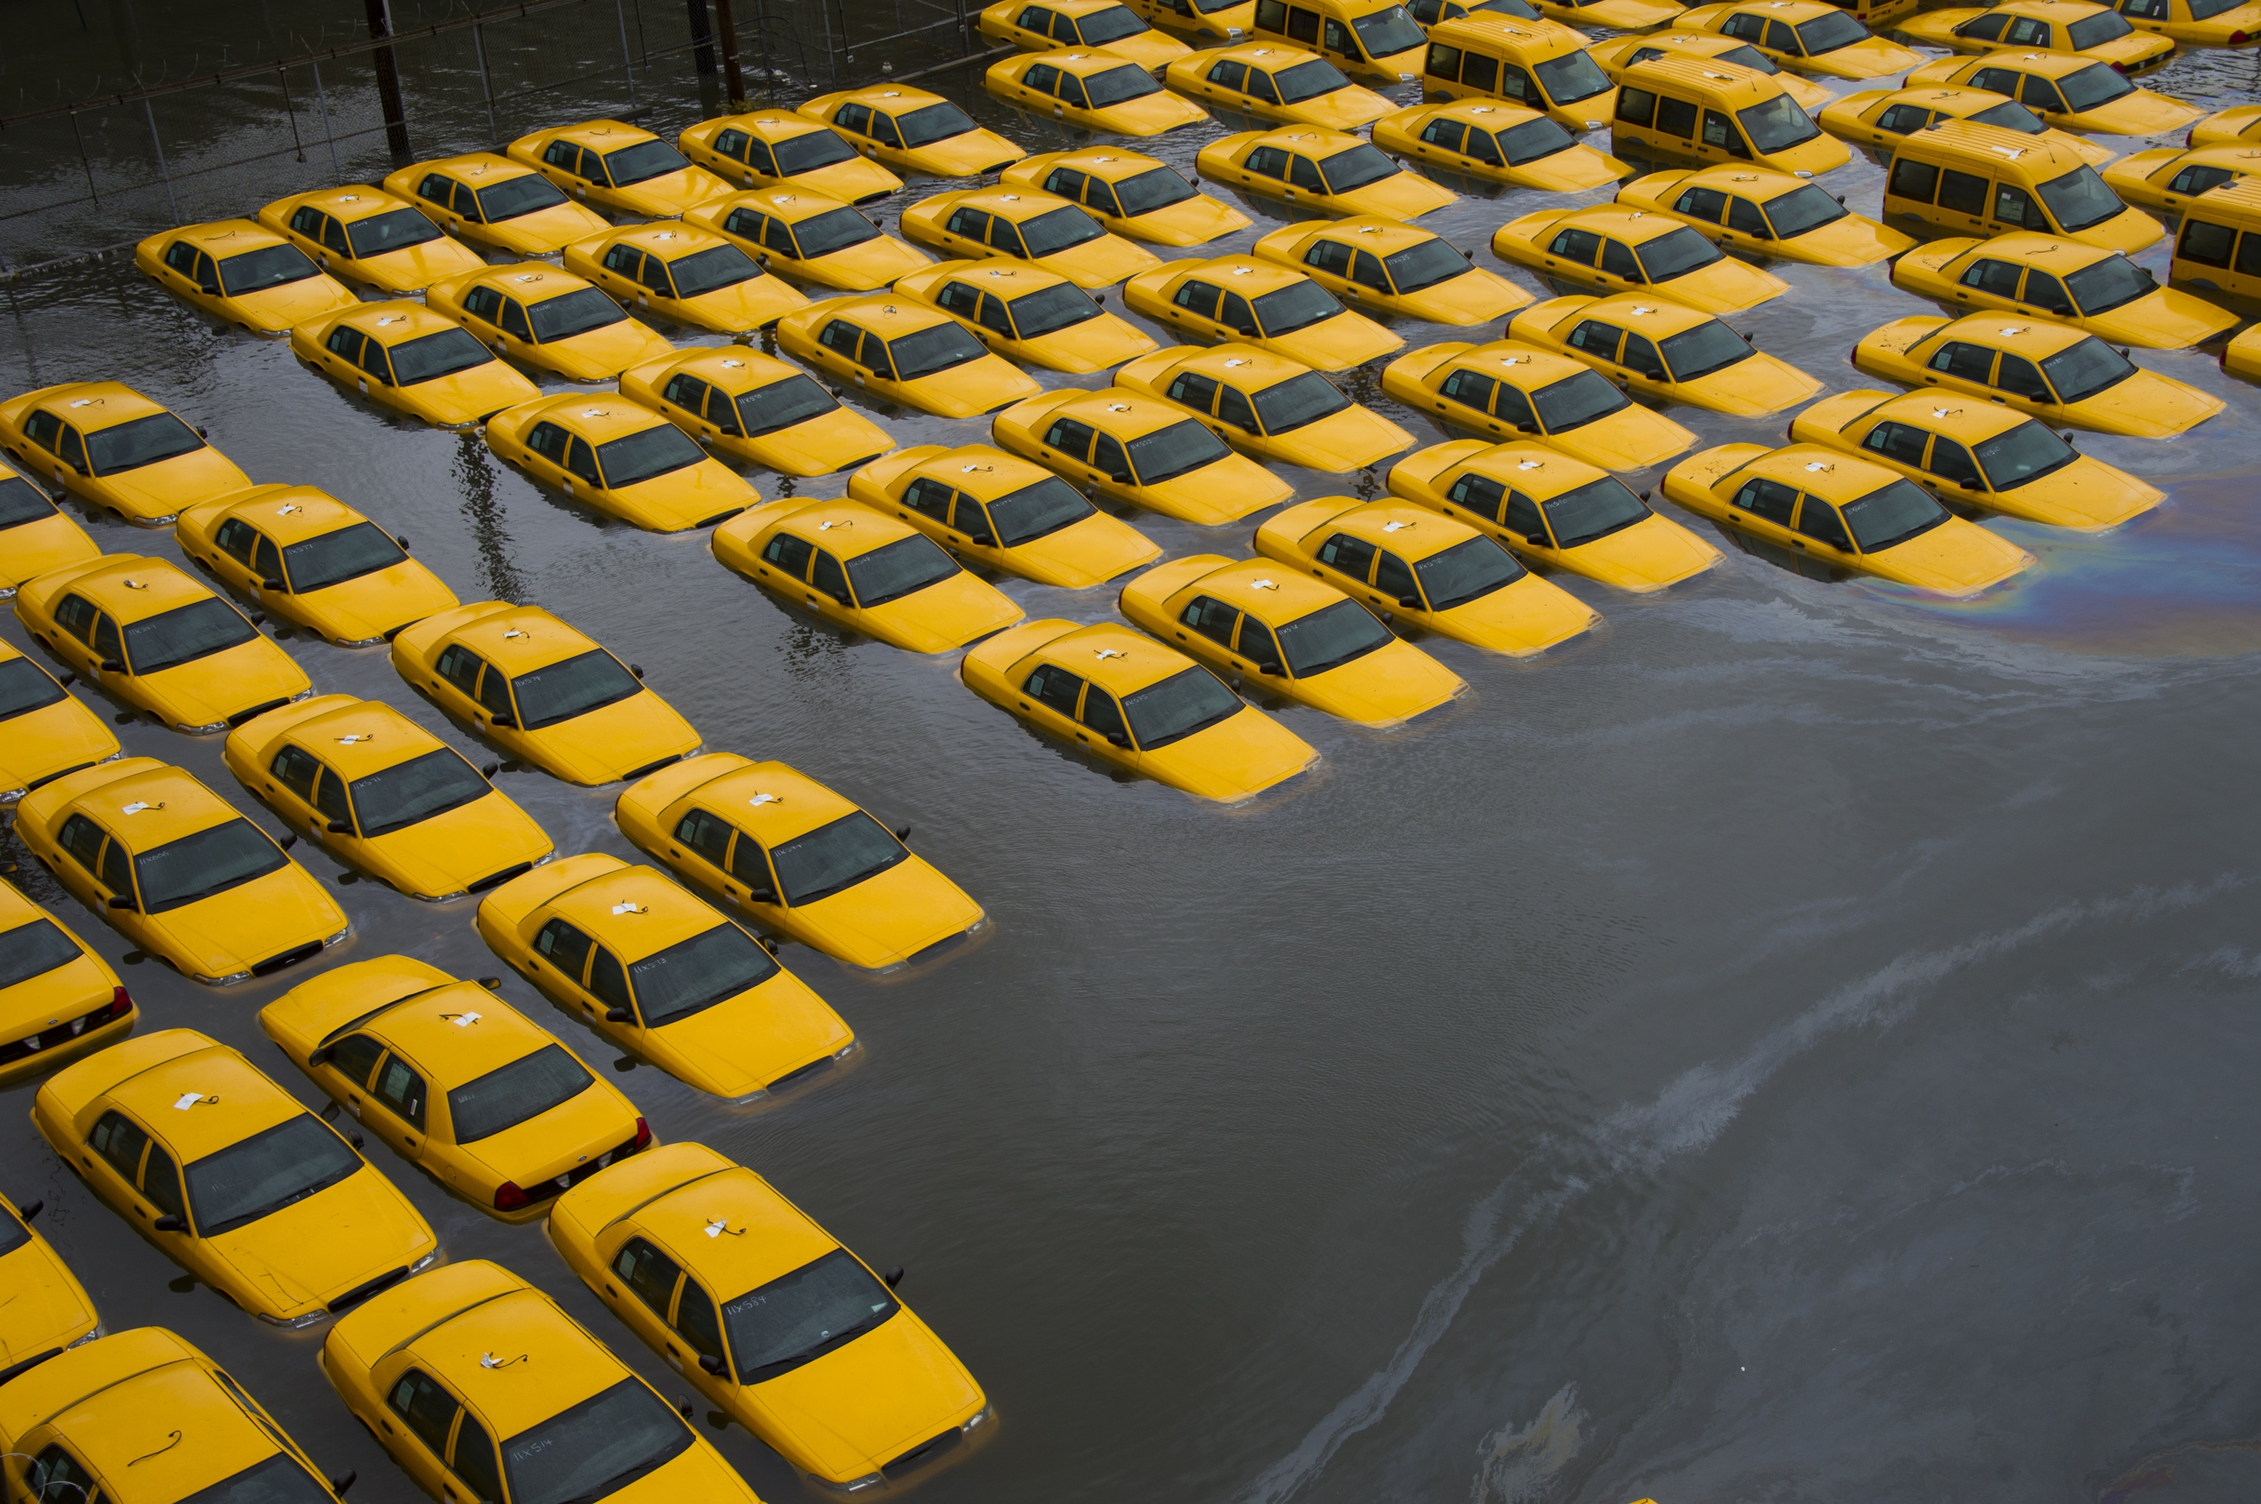
Scene-centric Abnormality

Slide 43
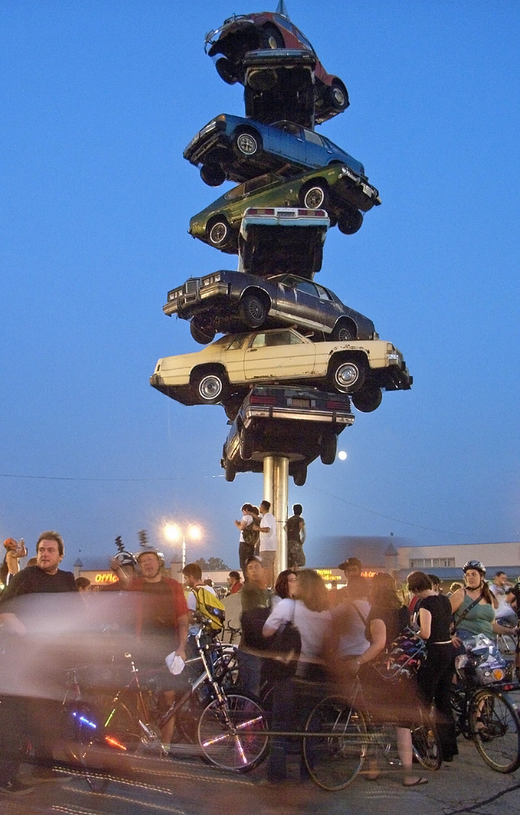
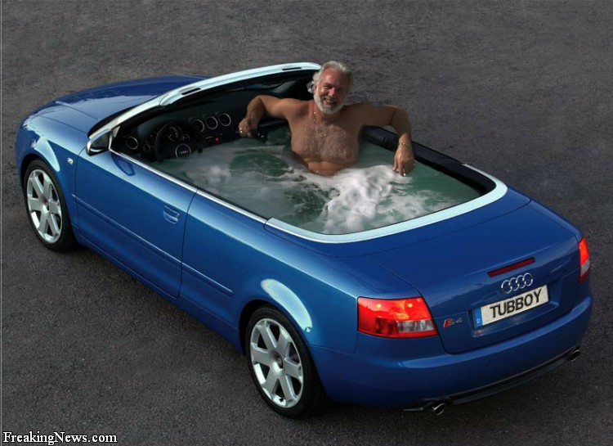
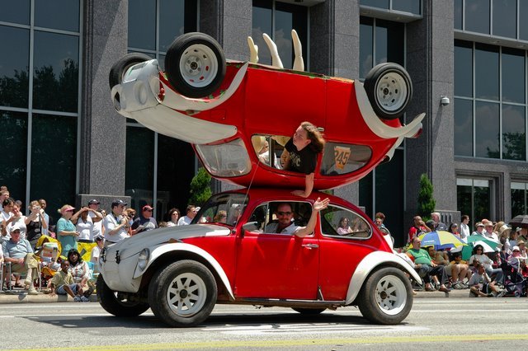
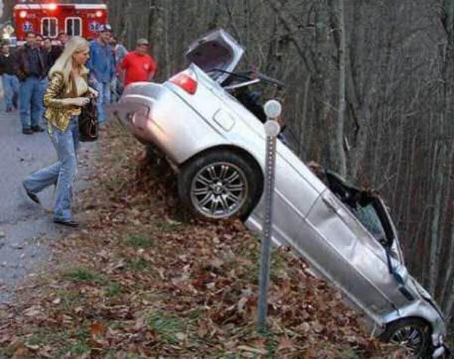
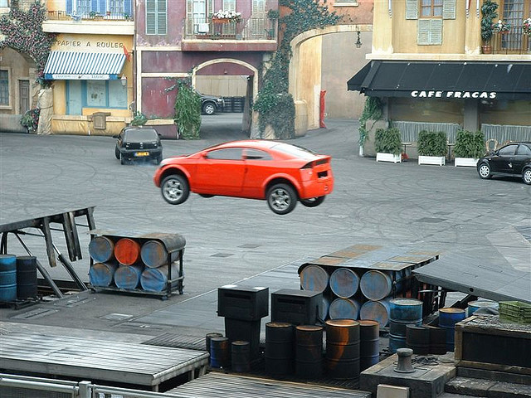
Contextual Abnormality

Slide 44
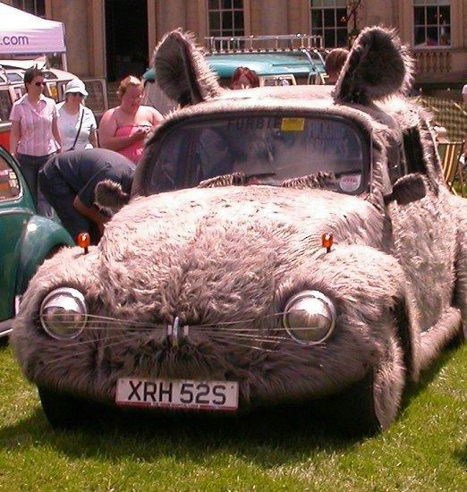
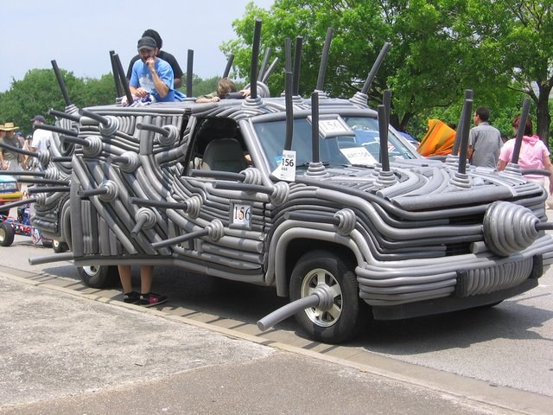
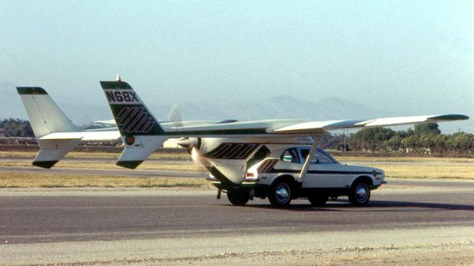
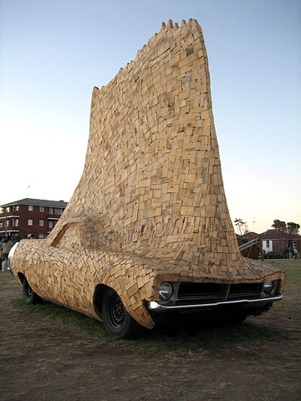
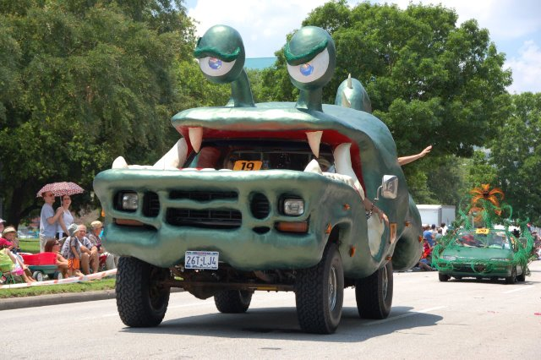
Object-centric Abnormality

Slide 45
Further analysis of
“Object—centric abnormality” cluster
Deeper (lower) hierarchical clusters do not provide informative grouping of reasons.
We hypothesize that :
Although variety of reasons provide helpful information, but might confuse human subjects in expressing their opinions.
Subjects refer to same visual concepts/reasons, but expressing it via different wording.
We used exploratory factor analysis to learn hidden factors that can explain all fine-grained reasons of abnormality in objects.
We use statistical significance measure to determine the minimum number of factors that are needed to explain the data. (common/principal factor analysis)

Slide 46
Two Inferred Factors in Object-centric
Abnormality Reasons
First Factor | 0.891447558743145 0.748373028770638 0.694005373675896 0.644901858617892 0.0790435014872081 | 'strange texture' 'strange material’ 'atypical pattern’ 'atypical color’ 'Object in shape of another object'
Second Factor | 0.958508457108101 0.535534222059008 0.331676465239351 0.0531447346520316 0.0322912279988133 | 'missing part’ 'Object is not complete’ 'misplaced part’ 'body posture' 'un-nameable shape'

Slide 47
Running K-means clustering on images, after projecting the human responses by using factor matrices.

Slide 48
Sample images taken from the first cluster

Slide 49
Sample images taken from the first cluster

Slide 50
Sample images taken from the second cluster

Slide 51
Sample images taken from the second cluster

Slide 52
K-Means Clustering of Abnormal Objects
Based on Projected Responses
First cluster 'atypical pattern' 'strange material' 'strange texture' 'atypical color' 'Strange contour (boundary)' 'unexpected part' 'Object in shape of another object' | Second cluster 'weird-shaped parts' 'Strange contour (boundary)' 'unexpected part' 'atypical pattern' 'Object in shape of another object'

Slide 53
Reason-based Abnormality Detection
Following the inferred taxonomy of abnormality, we build three computational models to measure how surprising is an image:
Object-centric surprise score
Scene-centric surprise score
Contextual surprise score
Notes:
having this graphical model and following the inferred taxonomy, we want to measure how surprising is an image based on : ...

Slide 54
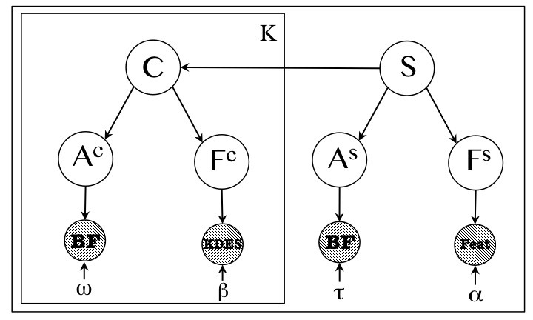
Modeling Normal Images
S: Scene category
C: Object category
F ^{s} F ^{c} : Vis. Feat for Scene/Object categorization
A ^{s} A ^{c} : Vis. Attributes for Scene/Object
This model is able to find three
main reasons of abnormality

Slide 55
Object-centric Surprise
Object category
Attribute reliability
Amount of surprise by observing i-th attribute for the given object category
Importance of i-th attribute for the given object category

Slide 56
Scene-centric Surprise
Attribute reliability
Amount of information by observing i-th attribute for the given scene category
Importance of i-th attribute for the given scene category

Slide 57
Contextual Surprise
Relative size of the object
Modeled by Gamma Dist.
Amount of information that location of the object reveals
Surprise rooted in the co-occurrence of object categories and scene

Slide 58
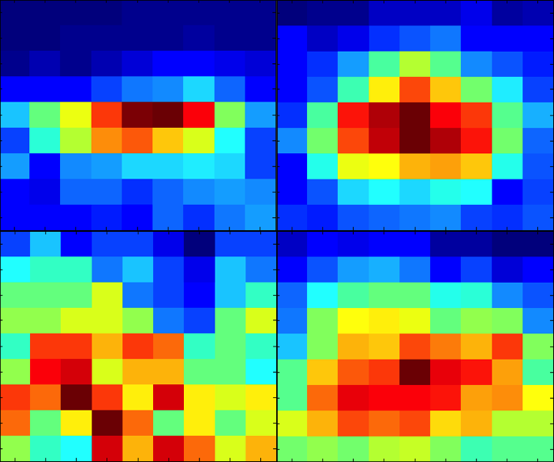
Contextual Surprise
Airplane
Boat
Heat map showing location of object categories in normal images.
Learn distribution of pixel assignments in normal images, and use it for finding abnormal location of a given object.
Chair
Car

Slide 59
Abnormality Scores
Raw surprise score are not comparable, and cannot be used to judge abnormality of an image.
However, raw surprise scores follow exponential distributions when we plot the histogram of values for normal images.
Surprise scores (object centric) for normal images
Notes:
we compare fitting different parametric
models to the empirical distributions of surprise scores,
computed over normal images. For model selection we consider
simplicity of the distribution, as well as how well it fits
the empirical data. We do so based on Akaike Information Criterion
(AIC) criteria.
We are interested in simpler distributions,
because of their better generalization and the ability
to derive simpler (sometime closed from) CDFs. Our experiments
show that independent of the reason of abnormality,
surprise scores follow exponential family of distributions.
We pick “Inverse Gaussian” distribution as the underlying
Distribution
Given these probabilistic models,
we can compute the probability of observing a given surprise
score instead of the raw surprise scores.

Slide 60
Abnormality Scores
are Inverse Gaussian CDF for Object, Scene, and context surprise.
Taking the maximum among the complimentary probability values for these reasons, indicates the most influential reason behind the atypicality of the image.
Surprise scores(scene centric) for normal images
Notes:
we compare fitting different parametric
models to the empirical distributions of three surprise scores,
computed over normal images. For model selection we consider
simplicity of the distribution, as well as how well it fits
the empirical data based on Akaike Information Criterion
(AIC)
We are interested in simpler distributions,
because of their better generalization and the ability
to derive simpler (sometime closed from) CDFs. Our experiments
show that independent of the reason of abnormality,
surprise scores follow exponential family of distributions.
We pick “Inverse Gaussian” distribution as the underlying
Distribution
Given these probabilistic models,
we can compute the probability of observing a given surprise
score instead of the raw surprise scores.

Slide 61
Dataset
Abnormal images:
Continues abnormality score [0,1]
Main reason of abnormality [cluster index in the inferred dendrogram]
Rating of fine-grained reasons of abnormality.
Normal images:
Standard dataset for image categorization (PASCAL)
Notes:
We have a dataset of abnormal images …..
To model normality we used standard datasets of object categorization

Slide 62
Experimental Setting
Object Representation:
64 Visual attributes.
Low-level features for categorization:
Kernel Descriptors [Bo et al, NIPS 2010]
Scene Representation:
102 Visual attributes [Patterson et al, CVPR 2012]
Scene categorization [Juneja et al, CVPR 2013]

Slide 63
Normal images : Blue
Abnormal Images : Red
Scene-centric
Object-centric
Notes:
----- Meeting Notes (4/16/14 20:52) -----
label blue and red

Slide 64
Abnormality Detection – Prior Art
Prior art in object-centric abnormality detection suffer from poor object classifiers (attribute-based). Our model also benefits from a richer set of visual features used for learning attribute classifiers.
Similar to our work, Park et al. built their models only based on normal images. However, our reasoning based on information theoretic terms outperforms their CRF-based model of supporting context and objects.

Slide 65
Abnormality Detection - Baselines
Our model is learned using only normal images, but outperforms two-way classifiers. Either trained via attributes or vanilla deep features.
We relate this to the complexity of visual world, which makes it hard to find support vectors. Also, training SVM classifiers suffer from imbalanced data very much.

Slide 66
Abnormality Detection–Ablation Exp.
This ablation experiment shows the importance of each component of our final mode, where we held out one reason at a time.
Clearly, the object-centric is the most important component of our performance in abnormality recognition in images.
We relate this to the the fact that majority of images in our dataset are atypical due to having abnormal object(s).

Slide 67
Abnormality Ranking

Slide 68
Abnormality in Perspective

Slide 69
Computational Models:
Role of Typicality in Object Classification
“The Role of Typicality in Object Classification: Improving The Generalization Capacity of Convolutional Neural Networks”; B. Saleh, A. Elgammal, J. Feldman. IJCAI 2016

Slide 70
Problem Definition
CNN object classifiers fail to recognize abnormal objects.
Normal
Normal
Abnormal
Abnormal

Slide 71
Problem Definition
Despite human vision, CNN models categorize abnormal objects with a high confidence.

Slide 72
Related Work
Connecting CNN with Neuroscience & Perception
[Yamnis et al.’14],
[Cadieu et al.’14],
Notes:
Speaking of human vision, there are some recent studies on connecting CNN with …
Cadieu et al shows that compare to other hand crafted features, representation in layers of CNNs is the most similar representation to IT and V4 coretx in the human brain
Also Yamnis et al showed that there is correlation between CNN activation functions and how regions of brain work in terms of neuron activations

Slide 73
Related Work
Analysis of failure modes for CNN
[Goodfellow et al.’15]
[Nguyen et al.’15]
Notes:
But CNN models fail as well …
investigations of such failures include work of Goodfellow et al that showed adding noises ...
Or the work of Nguyen et al shows that CNNs can be misledead to a great extent ... For example local pattern of a baseball and not any structure informaiton
In this work we believe that performance of CNN models can be improved by a more sophisticated learning strategy

Slide 74
Related Work
Training strategies for learning:
Technical specifications [Razavian et al.’14]
Learning rate
Batch size
Curriculum learning [Bengio et al.’09]
Order of the training samples are important.
Better classifiers are trained with seeing better examples first
Notes:
In this direction, there are an extensive list of studies on technical specifications for learning CNN models
Bengio et al have shown that the order of using training images is important in learning a concept. In other words, it is not a good idea to pick training examples via a random strategy.

Slide 75
Discriminative Models
Boundary examples
Generative Models
Center of density
Hybrid Models
Using generative hints in training discriminative models. Best of both worlds.
Not all abnormal samples are boundary examples.
Notes:
In this work we propose the idea of weighting training samples based on how typical they look like.
Ask people who work on generative modeling about the claim on important samples for generative models.

Slide 76
Approach - Weighting Samples
We propose a new training strategy for CNN:
Same training data (ImageNet), and same optimization (SGD)
Not all training examples are equally important
Modeling the importance of each training image based on how typical/normal it looks like
Weighting training sample during training as a function of their typicality.
At inference/test time, no need to measure the typicality of image
Even-degree Polynomials
To emphasize on both normal and abnormal samples
Suitable for hybrid model, where typicality is as important as atypicality (discriminative)
Notes:
Hack for the degree of polynomials

Slide 77
Alternative Weighting function
Internal scores of typicality
Entropy of the output of the layers of CNN resembles human’s opinions about the typicality [Lake et al’15]
We used these scores to re-train the same CNN
This approach predicts the typicality of test images as well

Slide 78
Approach - Loss functions
Inspired by human-learning, typicality of training samples is very important.
Sample-based weighting of training samples during the training, to incorporate how typical each sample is.
We tried two loss functions:
Softmax log-loss

Slide 79
Approach – Loss functions
Although Softmax loss is widely used in state-of-the-art object classifiers, there are better options for our setting.
Multi-class Hinge Loss, takes into account abnormality of a sample as it is captured by its fuzzy category membership.
Multi-class structured hinge loss
Notes:
This is the same as the mhinge loss, but computes the margin between the prediction scores first. This is also known the Crammer-Singer loss, an example of a structured prediction loss.

Slide 80
Experiments
Typicality estimation is based on a model that is trained via images in PASCAL dataset
For learning CNN, Train set is ImageNet train set (Normal), and Test set I consists of Abnormal (our dataset) and Normal images (ImageNet test set).
Test set II is consisting of Abnormal images (our dataset) and Normal images (PASCAL dataset).

Slide 81
Experiments
Evaluation of different loss functions
Typ : Raw Typicality scores
Atyp: Raw Atypicality scores
Cls-Typ : Class-specific Raw Typicality scores
Cls-Atyp: Class-specific Raw Atypicality scores

Slide 82
Experiments

Slide 83
Summary
There is a big gap between humans and computer vision, when it comes to atypical images.
Similar to human learning, we built algorithms that understand atypical images, without seeing them before.
We used information theory and visual attributes to show that computational reasoning correlates with human reasoning about abnormality.
Proposed a taxonomy for abnormality that has three main branches: Object, Context and Scene.
Incorporating typicality estimation in learning discriminative object classifiers improves the performance on both normal and abnormal objects.
Notes:
To summarize main part of my PhD research, ….

Slide 84
Future Work
Application of typicality estimation in detection and scene categorization.
Investigation of applications of typicality in image captioning, and its connections to image specificity or memorability.
Using prototype theory in learning visual classifiers with few training examples.
Incorporating typicality in training CNN to learn more robust feature representation.

Slide 85


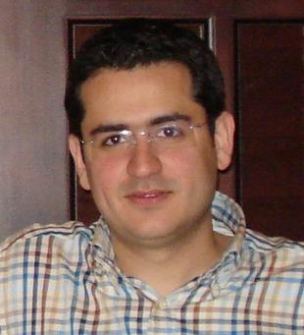
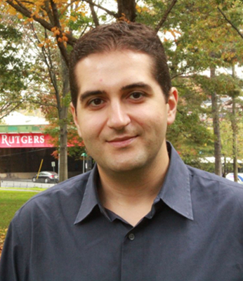

Thank you!

Slide 86
Related Work
Connecting CNN with Neuroscience & Perception
[Yamnis et al.’14],
[Cadieu et al.’14],
Notes:
Speaking of human vision, there are some recent studies on connecting CNN with …
Cadieu et al shows that compare to other hand crafted features, representation in layers of CNNs is the most similar representation to IT and V4 coretx in the human brain
Also Yamnis et al showed that there is correlation between CNN activation functions and how regions of brain work in terms of neuron activations

Slide 87
Related Work
Training strategies for learning:
Technical specifications [Razavian et al.’14]
Learning rate
Batch size
Curriculum learning [Bengio et al.’09]
Order of the training samples are important.
Better classifiers are trained with seeing better examples first
Notes:
In this direction, there are an extensive list of studies on technical specifications for learning CNN models
Bengio et al have shown that the order of using training images is important in learning a concept. In other words, it is not a good idea to pick training examples via a random strategy.

Slide 88
Experiments: PASCAL

Slide 89





Localized Attribute for Fine-grained Categorization
Part-Based Feature Extraction
Fine-Grained Categorization
F_{head} = [f₁, … ,f_{n}]
Regulating the
classifier with
Localized Attributes:
Red eye
Dark blue, black wing
Long blue tail
Dark green belly
F_{wing} = [f₁, … ,f_{n}]
F_{tail} = [f₁, … ,f_{n}]
F_{belly} = [f₁, … ,f_{n}]
Bronzed Cowbird
Fine-grained object categorization with localized attributes. B. Saleh, A. Elgammal. CVPRW’15.

Slide 90
Localized Attribute for Fine-grained Categorization
Part-based description of object categories empower the model with zero-shot learning of new object classes.
Fine-grained object categorization with localized attributes. B. Saleh, A. Elgammal. CVPRW’15.

Slide 91
The Bronzed Cowbird (once known as the Red-eyed Cowbird), Molothrus aeneus, is a small icterid.
It breeds from the southern U.S. states of California, Arizona, New Mexico, Texas, and Louisiana south through Central America to Panama. An isolated population on the Caribbean coast of Colombia is sometimes treated as a separate species, the Bronze-brown Cowbird (M. armenti).
The male Bronzed Cowbird is 20 cm long and weighs 68 g, with green-bronze glossed black plumage and red eyes. The female is 18.5 cm long and weighs 56 g. She is duller black above and browner below. Young birds are like the female but have grey feather fringes.
Like all cowbirds, this bird is a brood parasite: it lays its eggs in the nests of other birds. The young cowbird is fed by the host parents at the expense of their own young. Hosts include Prevost's Ground-Sparrow and Yellow-throated Brush Finch.

Slide 92
Write a Classifier
Rather than sample-base categorization, learning the visual classifier for a category, only based on its pure textual description.
Write a classifier: Zero-shot learning using purely textual descriptions. M. Elhosseiny, B. Saleh, A. Elgammal. ICCV’13
Notes:
Write a classifier: Zero-shot learning using purely textual descriptions

Slide 93
Formulation I: Regression
A set of one-vs-all classifiers {c_{k}} are learned, one for each seen class. Given {(t_{k}; c_{k})}, a regressor is learned that can be used to give a prior estimate for p_{reg} (c|t)
The predicted classifier for textual feature vector t* is obtained as
c_{reg} (t*) = arg max_{c} [p_{reg} (c|t*)]

Slide 94
Formulation II: Domain Adaptation
W (Domain Adaptation) can be learned by optimizing, with a suitable regularizer, over constraints of the form t^{T} W x > l if t and x belong to the same class, and t^{T} W x < u otherwise.
It is not hard to see that this transfer function can act as a classifier. Given a textual feature t and a test image, represented by x , a classification decision can be obtained by t^{T} W x > b
The predicted classifier is obtained as c_{DA} (t*) = t*^{T} W
Notes:
We also modified this model to penalize deviation of t_{k}^{T} W from c_{k} seen classifier.

Slide 95

Notes:
{x_{i} , i=1:N} are the visual features of the images of the seen classes.
Given ln p_{reg} (c|t) from the TGP and W , this equation reduces to a quadratic program on c with linear constraints

Slide 96
Summary
Collected a large dataset of annotated abnormal images.
Conducted human-subject experiments to investigate human thinking about abnormality.
Taxonomy of visual abnormalities, motivated by human-subject experiments.
Computational models to detect and reason about abnormality in images.

Slide 98
Guidelines for Future Work
Constant interaction between humans and machines (agents) will lead to improve the intelligence on both sides.
Putting humans in the loop, and Learn from them, far beyond provided annotations.
Benefit of having access to more data should not be limited to larger benchmarks, but also enabling us to extract more knowledge.

Slide 99
Publications
“Object-Centric Anomaly Detection by Attribute-Based Reasoning”; B. Saleh, A. Farhadi, A. Elgammal. CVPR 2013
“Detecting Strange Object via Visual Attributes”; B. Saleh, A. Elgammal, A. Farhadi. ECCVW 2014
“Toward a Taxonomy and Computational Models of Abnormalities in Images”; B. Saleh, A. Elgammal, J. Feldman, A. Farhadi. AAAI 2016
“The Role of Typicality in Object Classification: Improving The Generalization Capacity of Convolutional Neural Networks”; B. Saleh, A. Elgammal, J. Feldman. IJCAI 2016
“Wow! That looks strange: Computational Models for Detection and Reasoning about Abnormalities in Images”; B. Saleh. AI Matters 2016
“Toward Building Computational Models For Detecting and Reasoning About Abnormalities in Images”; B. Saleh, A. Elgammal, J. Feldman, A. Farhadi. ICMLW 2016, In Preparation for JAIR 2016

Slide 100
Approach - Weighting functions
Raw typicality / atypicality
Probability of being normal vs. abnormal
Class-specific typicality/atypicality
Defined, when samples are taken from one category
Logarithmic score of (class-specific) typicality
To allow more smooth weighting of sampling. It also can level the noise involved in typicality estimation
Even-degree Polynomials
To emphasize on both normal and abnormal samples
Suitable for hybrid model, where typicality is as important as atypicality (discriminative)
Notes:
Hack for the degree of polynomials

Slide 101
Approach - Weighting functions
Internal scores of typicality
Entropy of the output of the layers of CNN resembles human’s opinions about the typicality [Lake et al’15]
We used these scores to re-train the same CNN

